Slide 1
DOCUMENTATION
Cricket Registration Website Documentation
Introduction
The cricket registration website is an online platform designed to facilitate the registration process for cricket players, teams, and leagues. It aims to streamline the process of organizing cricket events and managing participant information efficiently.
Features
User Registration:
Players, team managers, and league organizers can register accounts on the platform.
Registration requires basic personal information and contact details.
Player Registration:
Players can register individually or as part of a team.
Required information includes player details, such as name, age, contact information, playing position, and skill level.

Slide 2
Team Registration:
Team managers can create and register teams for participation in leagues and tournaments.
Information includes team name, captain details, team logo, and player roster.
League Registration:
League organizers can create and manage cricket leagues or tournaments.
Registration involves specifying league details, such as format, schedule, rules, and registration fees.
Payment Integration:
Secure payment gateway integration for processing registration fees.
Supports multiple payment methods, including credit/debit cards, PayPal, etc.
Event Management:
Schedule creation and management for matches, tournaments, and league fixtures.
Automated notifications for participants about match schedules, venue changes, etc.
User Dashboard:
Personalized dashboards for players, team managers, and league organizers.
Access to registration status, upcoming matches, payment history, etc.

Slide 3
Admin Panel:
Comprehensive admin panel for managing users, teams, leagues, and events.
Tools for reviewing registrations, handling disputes, and generating reports.
Technology Stack
Frontend: HTML5, CSS3, JavaScript (React.js)
Backend: Node.js, Express.js
Database: MongoDB
Authentication: JWT (JSON Web Tokens)
Payment Gateway: Stripe
System Architecture
Client-Server Model: Frontend communicates with the backend server through RESTful APIs.
Database Management: MongoDB for storing user data, team information, league details, etc.
Scalability: Cloud-based infrastructure for scalability and reliability.
Security Measures
SSL Encryption: Secure data transmission over HTTPS protocol.
Data Encryption: Sensitive user information encrypted at rest and in transit.
Authentication & Authorization: JWT-based authentication for secure user access.

Slide 4
Input Validation & Sanitization: Prevents common vulnerabilities like SQL injection, XSS attacks, etc.
Deployment
Cloud Hosting: Deployed on platforms like AWS, Azure, or Google Cloud for scalability and reliability.
Continuous Integration/Continuous Deployment (CI/CD): Automated deployment pipelines for efficient updates and maintenance.

Slide 5
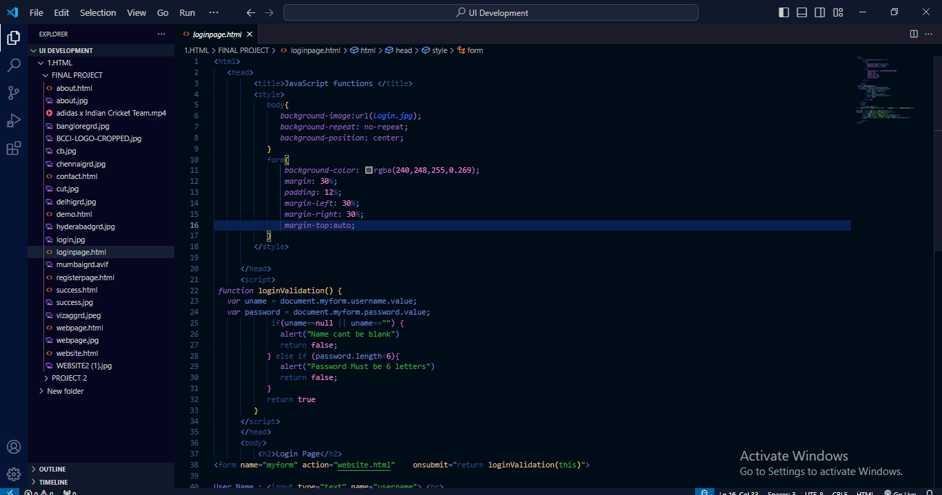
CODE

Slide 6
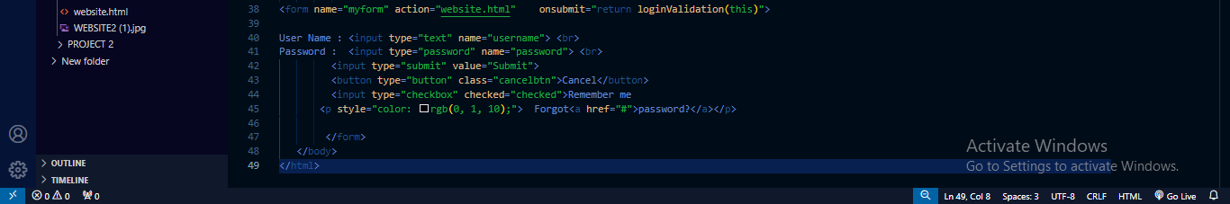

Slide 7


Slide 8
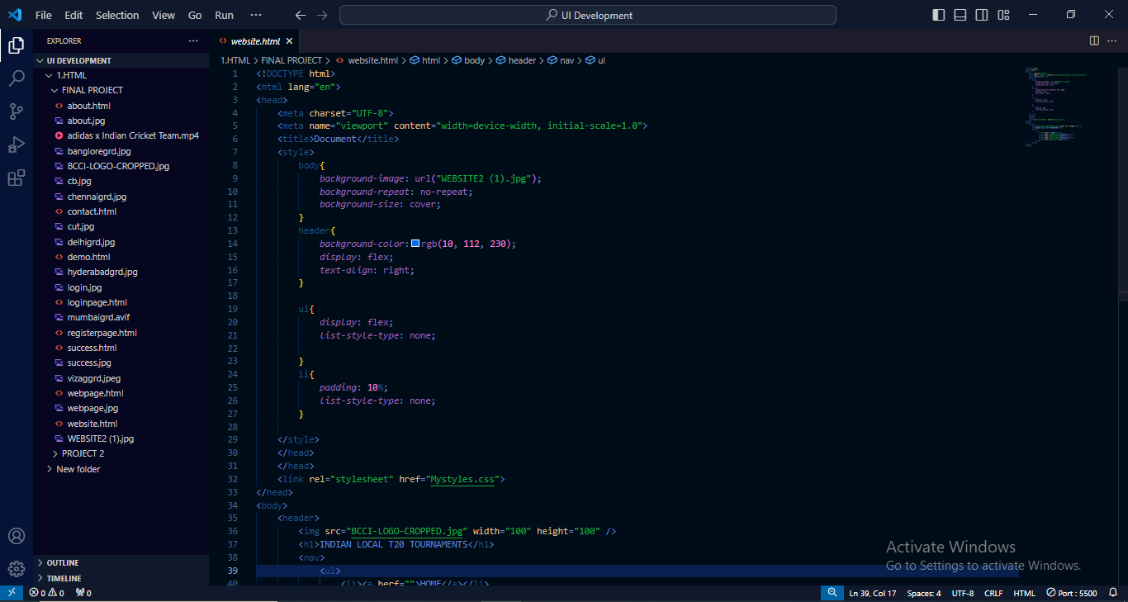
CODE

Slide 9
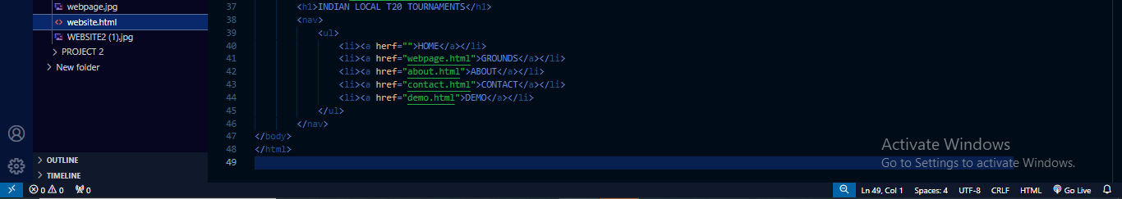

Slide 10

OUTPUT

Slide 11
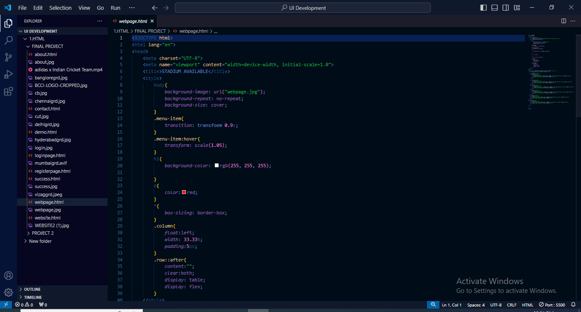
CODE

Slide 12
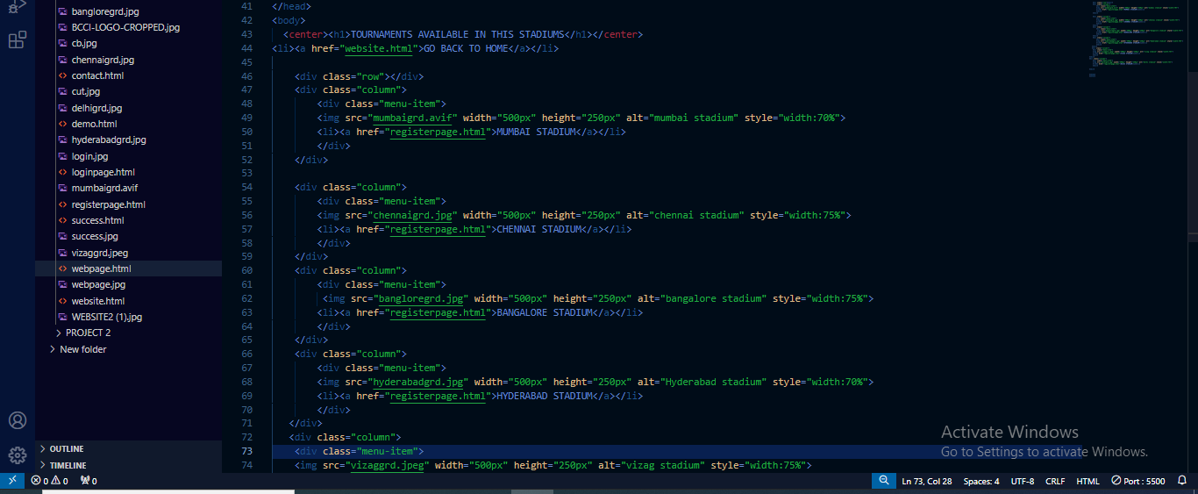

Slide 13
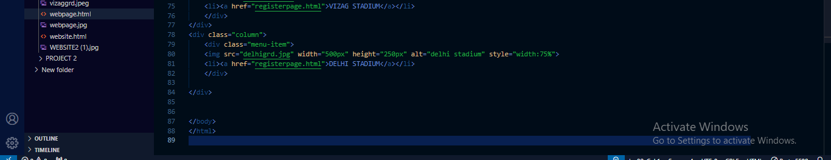

Slide 14
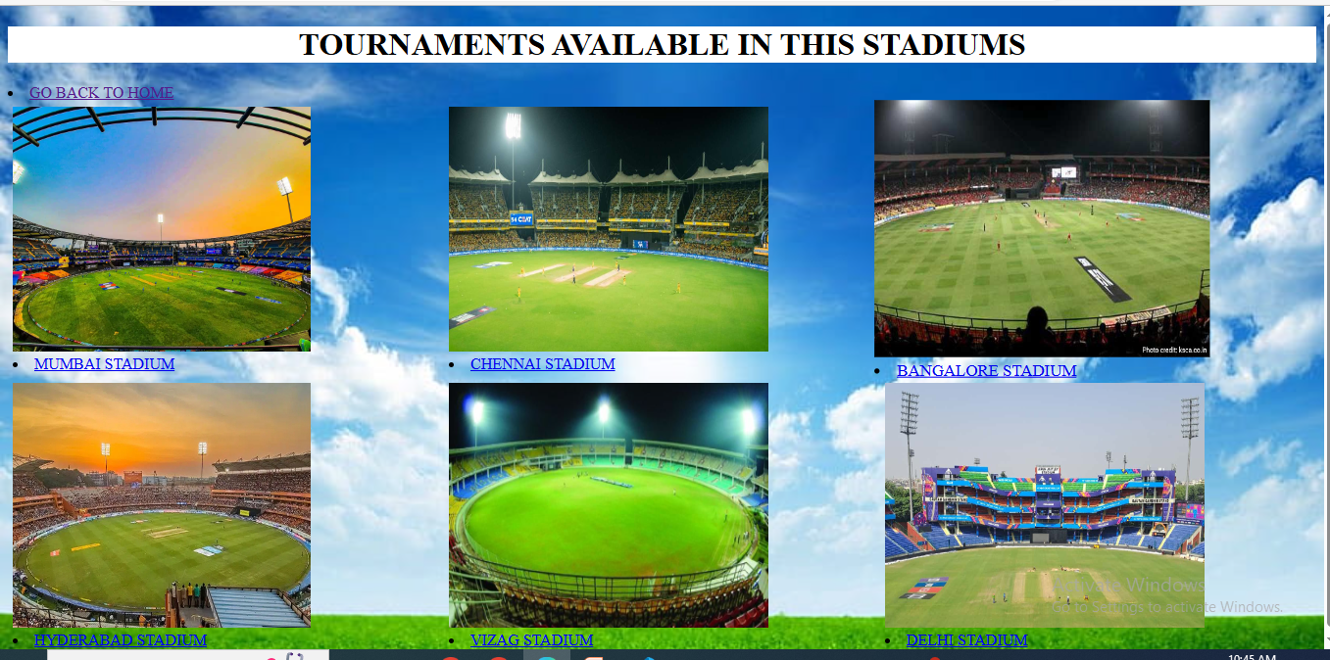
OUTPUT

Slide 15
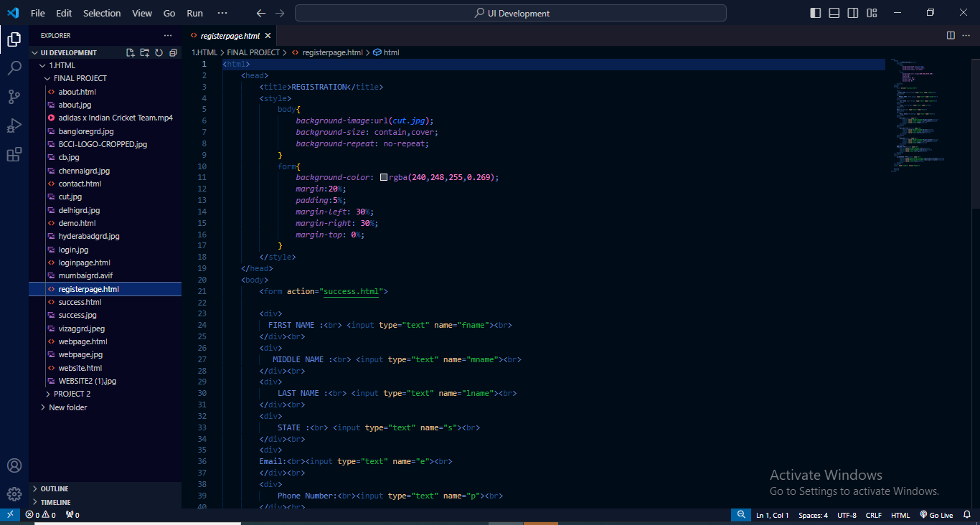
CODE

Slide 16
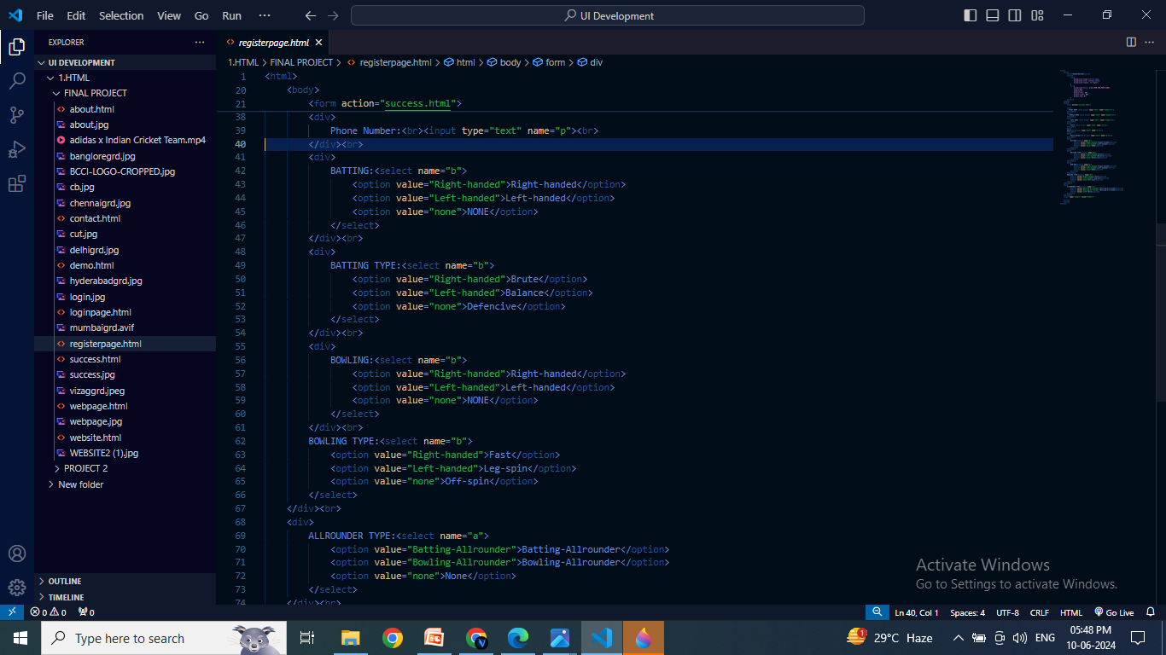

Slide 17
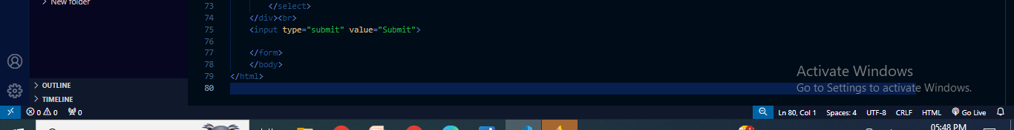

Slide 18

OUTPUT

Slide 19
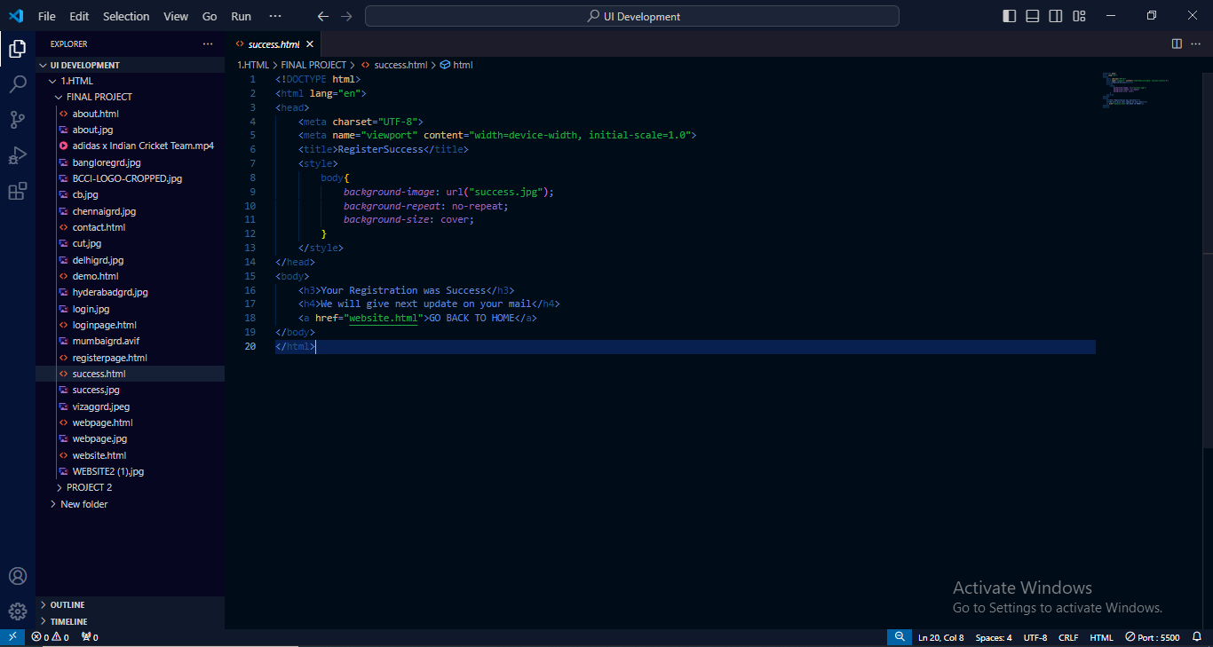
CODE

Slide 20

OUTPUT

Slide 21
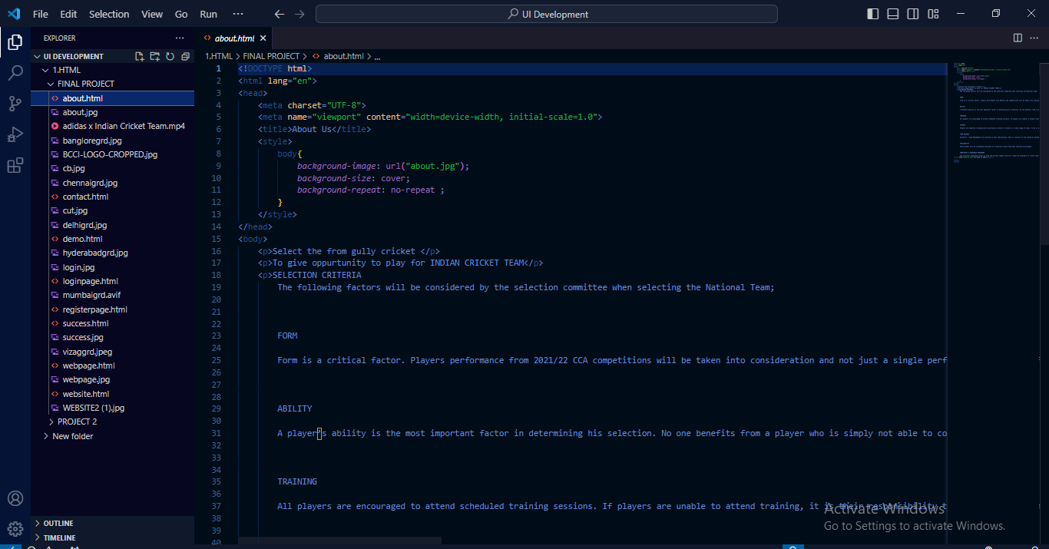
CODE

Slide 22
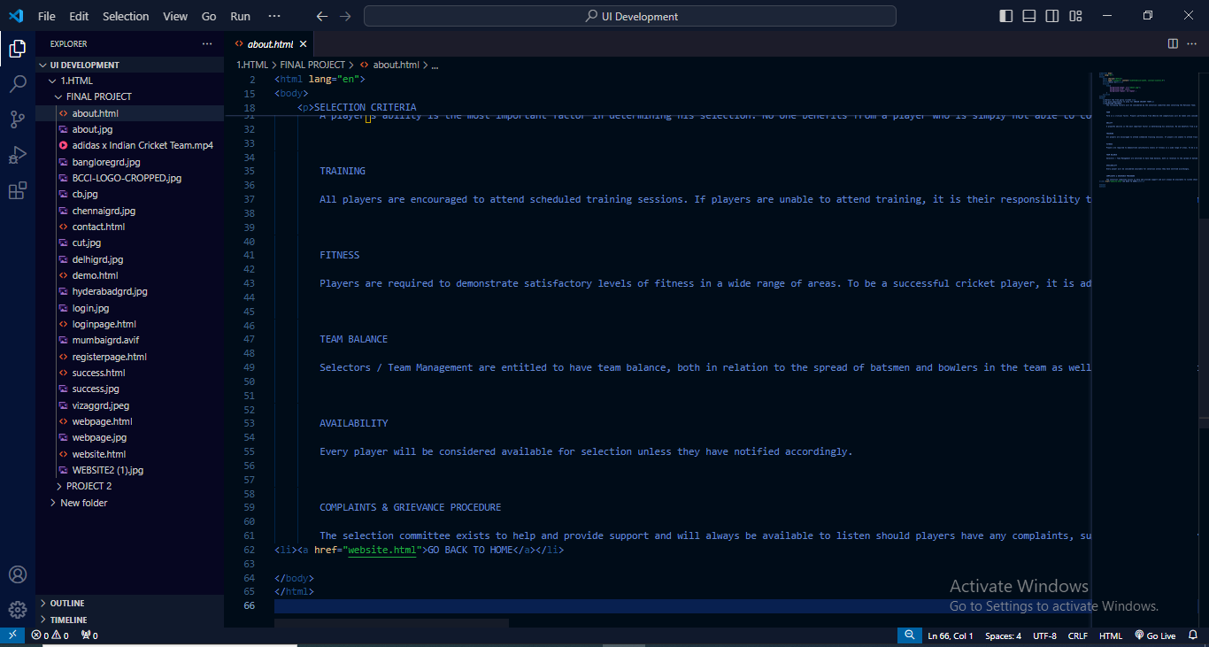

Slide 23

OUTPUT

Slide 24
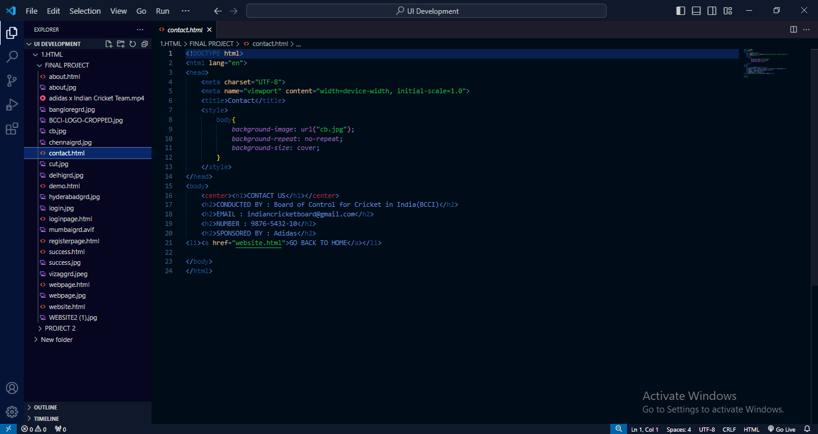
CODE

Slide 25

OUTPUT

Slide 26
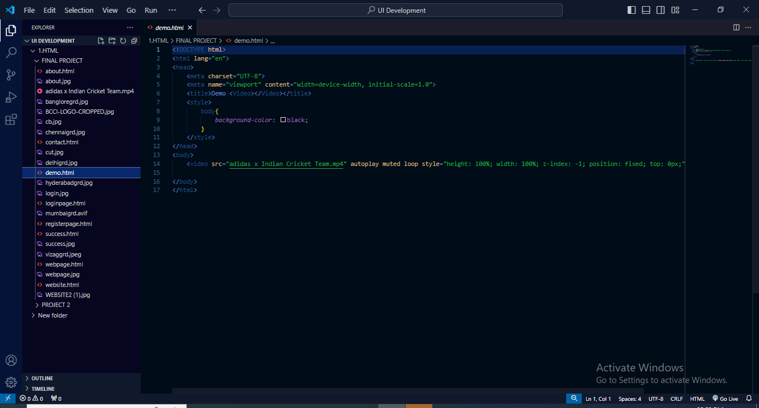
CODE

Slide 27

OUTPUT

Slide 28
Conclusion
The cricket registration website simplifies the process of organizing cricket events by providing an intuitive platform for players, teams, and league organizers. With its comprehensive features and robust architecture, it ensures a seamless registration experience and efficient management of cricket tournaments and leagues.

